Slide 1

Topic: Control Volume analysis of 1st Law
Lecture – 7
Disclaimer:
The study materials/presentations are solely meant for academic purposes and they can be reused, reproduced, modified, and distributed by others for academic purposes only with proper acknowledgements.

Slide 2
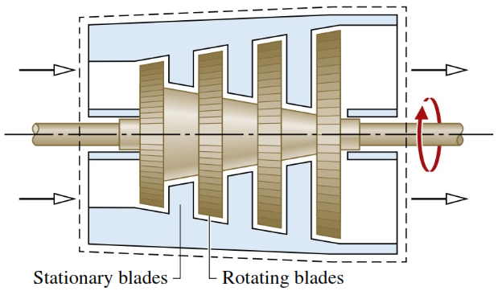
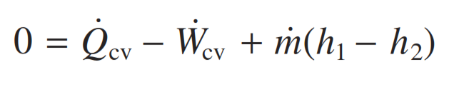
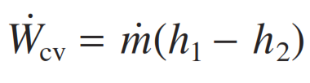
  Turbines:
  A turbine is a device in which power is developed as a result of a gas or liquid passing through a set of blades attached to a shaft free to rotate.
  Turbines are widely used for power generation in vapor power plants, gas turbine power plants, and aircraft engines.
  Turbines are also key components of wind-turbine power plants that, are renewable means for generating electricity.
  For a steam or gas turbine, the net kinetic and potential energy of the matter flowing across the boundary is usually small enough to be neglected. Therefore,
  Again, the heat transfer between the turbine and surroundings is often small enough relative to the power and enthalpy terms that it also can be neglected.

Slide 3
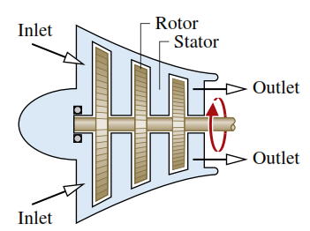
  Compressors and Pumps:
  Compressors and pumps are devices in which work is done on the substance flowing through them in order to typically increase the pressure and/or elevation of the substance.
  The term compressor is used when the substance is a gas (vapor) and the term pump is used when the substance is a liquid.
  The axial-flow compressor shown in figure is a key component of turbojet engines. Other types are reciprocating, centrifugal compressor, etc.
  The mass and energy rate balances reduce at steady state as for the case of turbines.
  Next we will discuss heat exchangers.

Slide 4
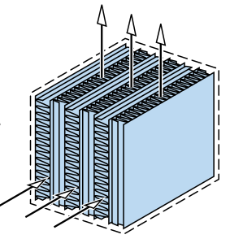
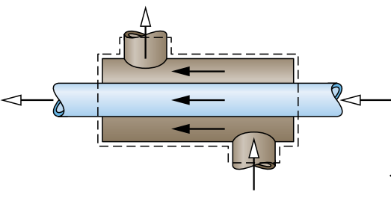
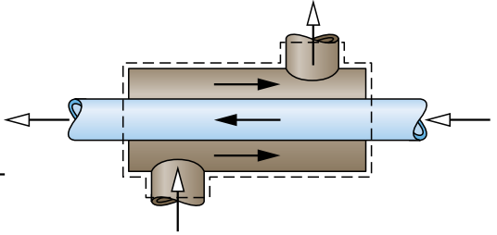
  Heat exchanger:
  Heat exchangers are used in home heating and cooling systems, automotive systems, electrical power generation, and chemical processing.
  A common type of heat exchanger is one in which a gas or liquid is separated from another gas or liquid by a wall through which energy is conducted.
  These heat exchangers take many different forms. Counterflow, parallel flow (having tube-within-a-tube ) or cross flow configurations.

Slide 5
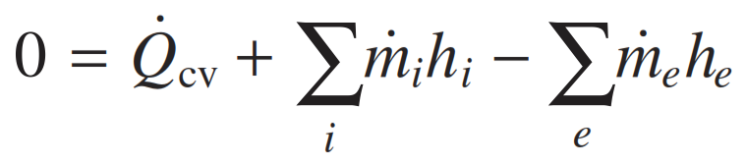
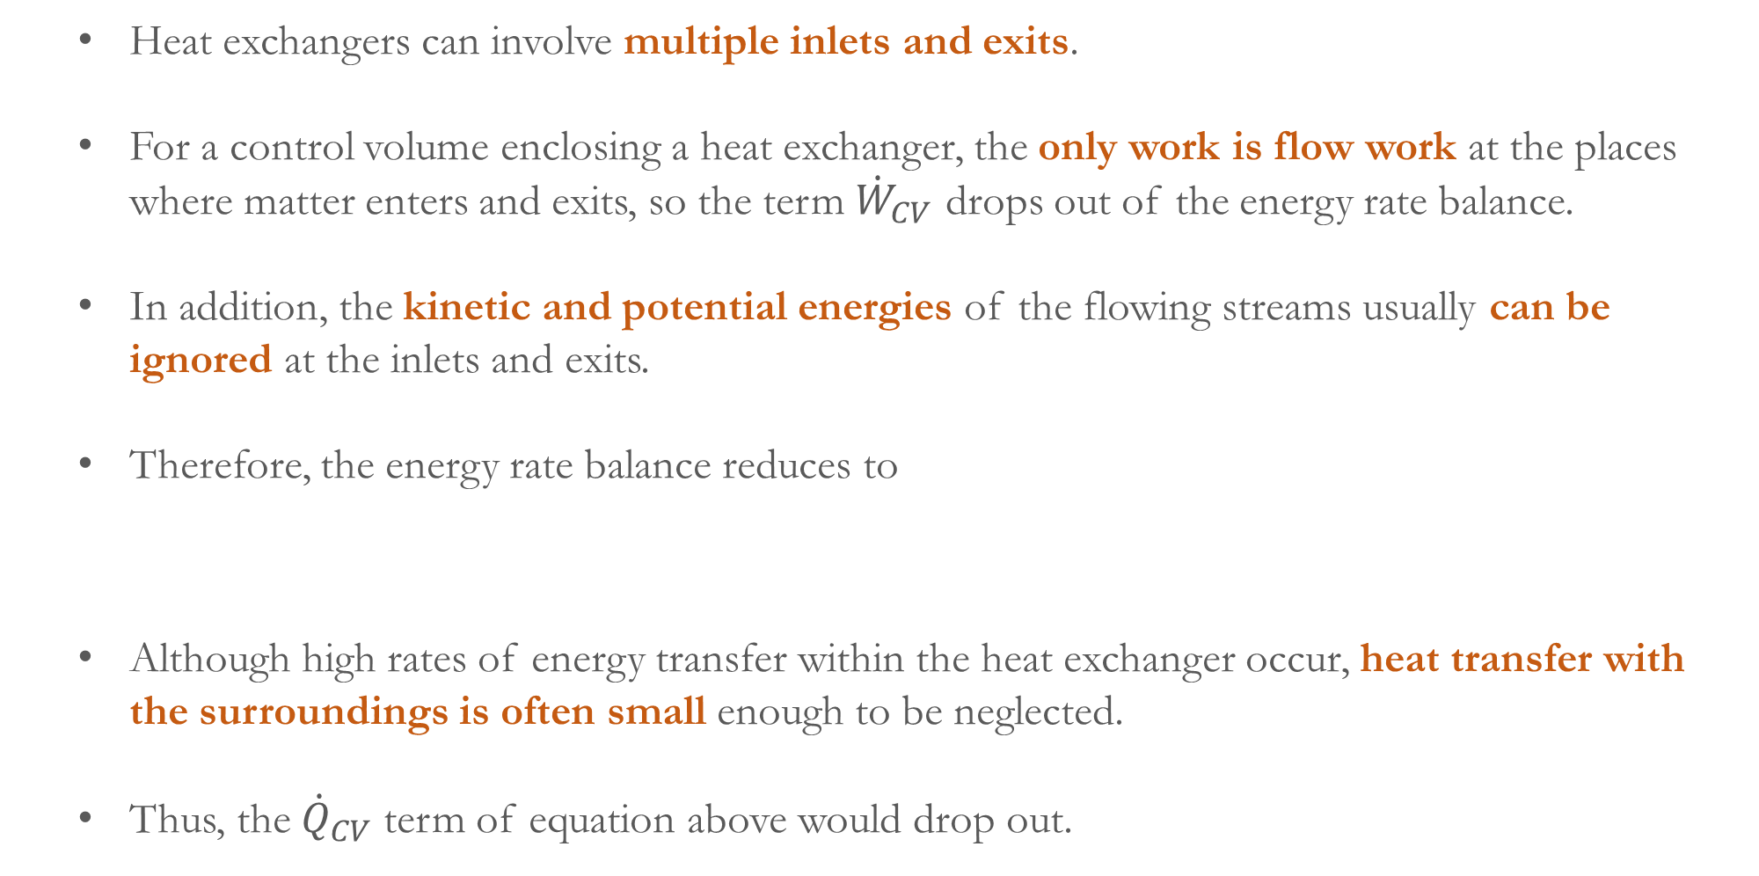
  Heat exchangers can involve multiple inlets and exits.
  For a control volume enclosing a heat exchanger, the only work is flow work at the places where matter enters and exits, so the term ${\dot{W}}_{CV}$ drops out of the energy rate balance.
  In addition, the kinetic and potential energies of the flowing streams usually can be ignored at the inlets and exits.
  Therefore, the energy rate balance reduces to
  Although high rates of energy transfer within the heat exchanger occur, heat transfer with the surroundings is often small enough to be neglected.
  Thus, the ${\dot{Q}}_{CV}$ term of equation above would drop out.

Slide 6
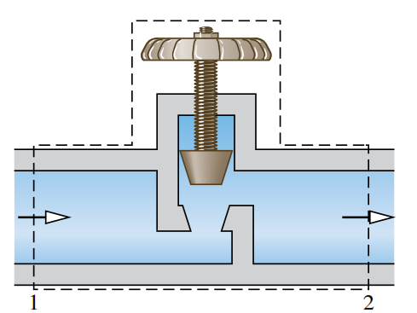
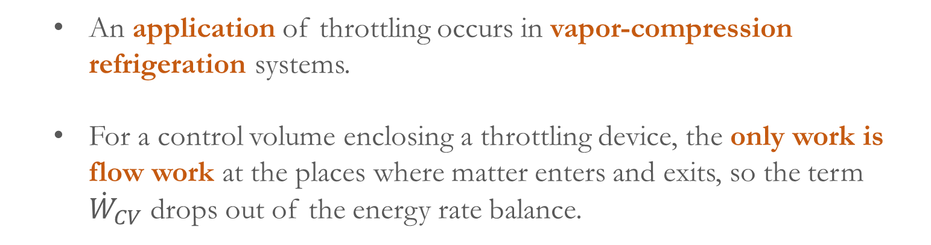
  Throttling device:
  A significant reduction in pressure can be achieved simply by introducing a restriction into a line through which a gas or liquid flows. This is commonly done by means of a partially opened valve, know as throttling device.
  An application of throttling occurs in vapor-compression refrigeration systems.
  For a control volume enclosing a throttling device, the only work is flow work at the places where matter enters and exits, so the term ${\dot{W}}_{CV}$ drops out of the energy rate balance.
  There is usually no significant heat transfer with the surroundings, and the change in potential energy from inlet to exit is negligible.
  Therefore, the energy rate balance reduces to:

Slide 7
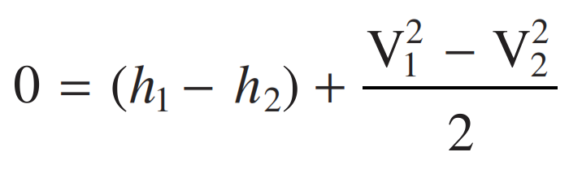
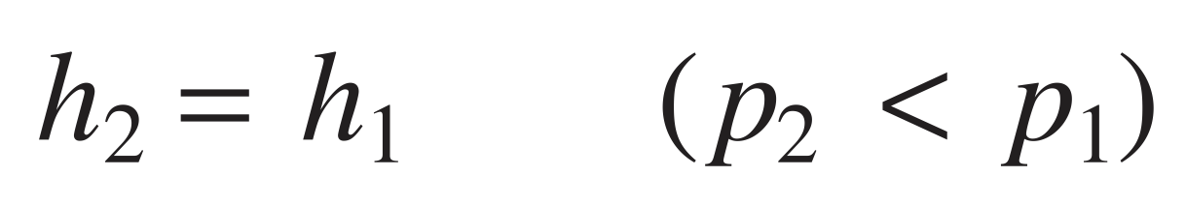
  Although velocities may be relatively high in the vicinity of the restriction, the change in the specific kinetic energy at upstream and downstream of the reduced flow area can be neglected.
  With this further simplification,
  When the flow through the valve or other restriction is idealized in this way, the process is called a throttling process.
  Transient analysis:
  Many devices undergo periods of transient operation during which the state changes with time. Examples include the startup or shutdown of turbines, compressors, and motors. Additional examples include vessels being filled or emptied.

Slide 8
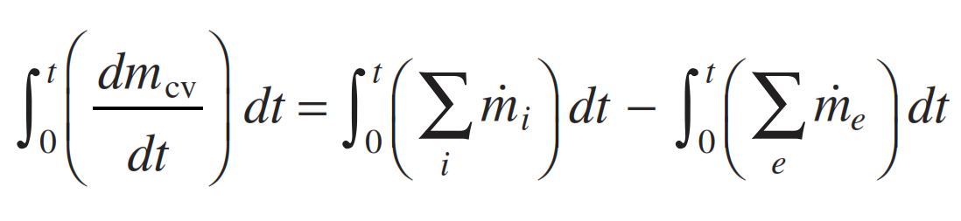
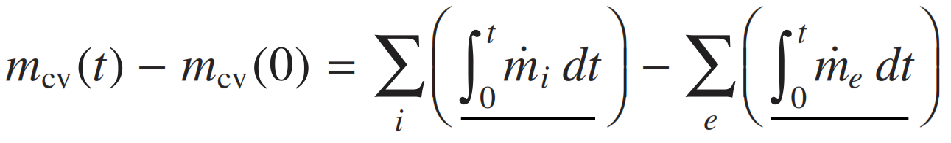
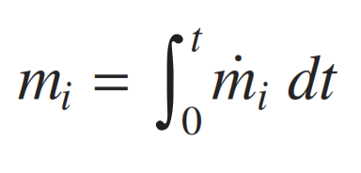
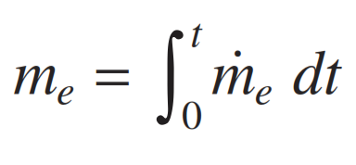
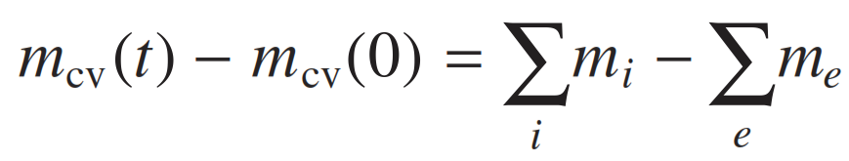
  The Mass Balance: We begin by integrating the mass rate balance from time 0 to a final time t.
  This takes the form
  Introducing the symbols for the underlined terms
  the mass balance becomes,

Slide 9
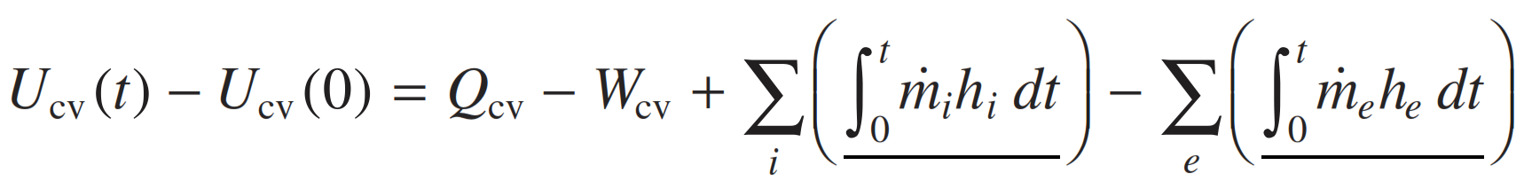
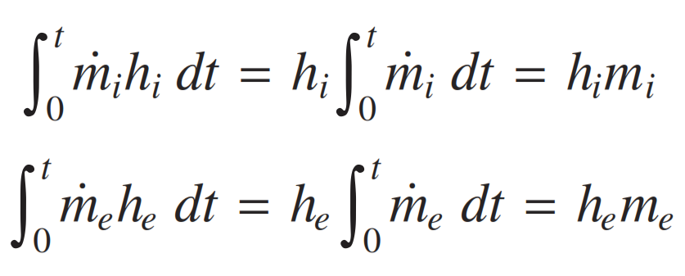
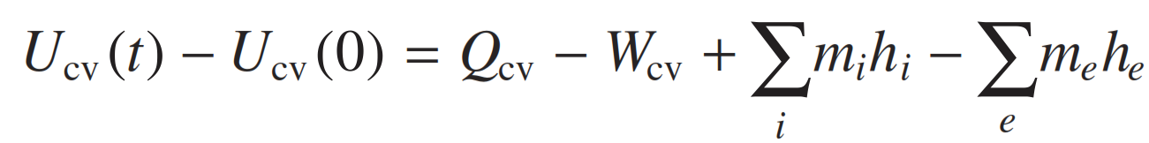
  The Energy Balance: We integrate the energy rate balance, ignoring the effects of kinetic and potential energy.
  For the special case where the states at the inlets and exits are constant with time
  Energy balance equation takes the following special form,
  Numerical problems

Slide 10
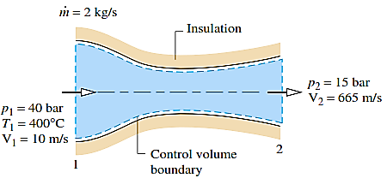

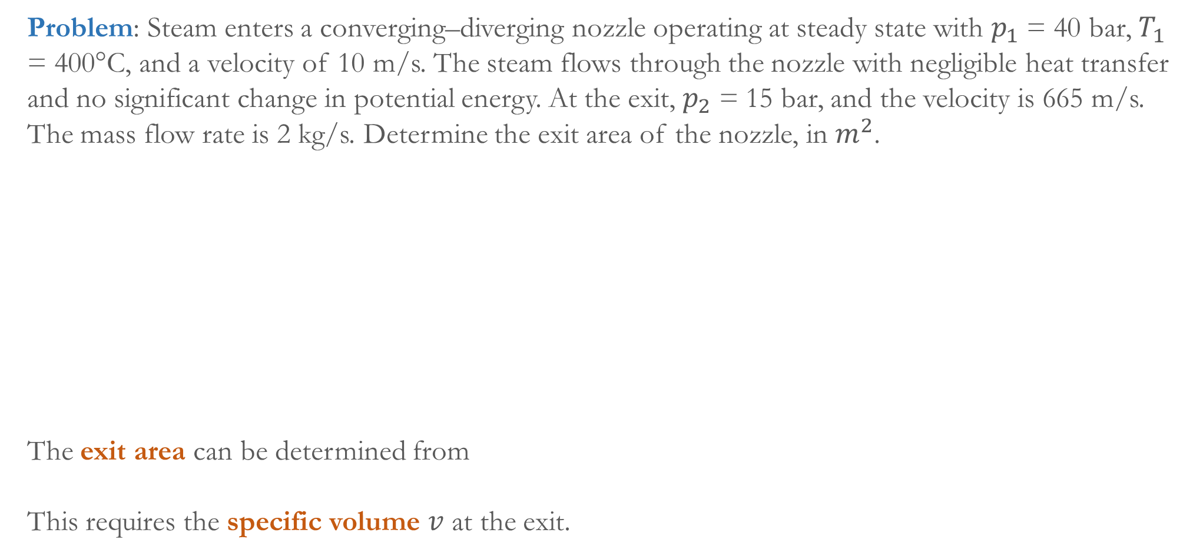
  Problem: Steam enters a converging–diverging nozzle operating at steady state with $p_{1}$ = 40 bar, $T_{1}$ = 400°C, and a velocity of 10 m/s. The steam flows through the nozzle with negligible heat transfer and no significant change in potential energy. At the exit, $p_{2}$ = 15 bar, and the velocity is 665 m/s. The mass flow rate is 2 kg/s. Determine the exit area of the nozzle, in $m^{2}$.
  The exit area can be determined from
  This requires the specific volume $v$ at the exit.

Slide 11
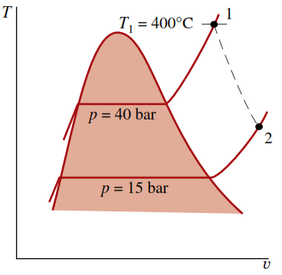

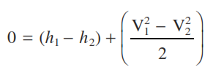
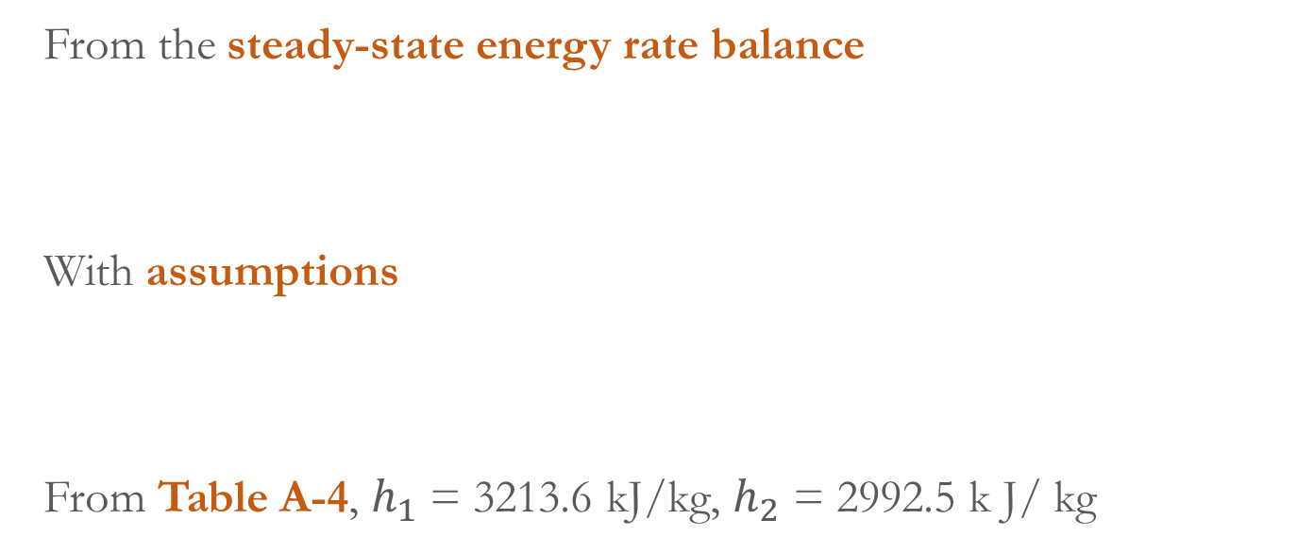
  Now, the state at the exit is fixed by the values of two independent intensive properties.
  Pressure (given) and specific enthalpy (need to be evaluated).
  From the steady-state energy rate balance
  With assumptions
  From Table A-4, $h_{1}$ = 3213.6 kJ/kg, $h_{2}$ = 2992.5 k J/ kg

Slide 12


  From the Table
  Therefore, the exit area is

